Slide 1

SPARK CASE COMPETITION
Careasy \\ Season 1
Aayush Gupta
IIM Ahmedabad (MBA)
Professional Associations:
Strategy&; Deloitte
Aarushi Agarwal
IIM Ahmedabad (MBA)
Professional Associations:
Kearney, TATA Communications
Ananta Chhajer
IIM Ahmedabad (MBA)
Professional Associations:
Aditya Birla Group; ZS

Slide 2
Market analysis
App strategy
Branding strategy
Partnerships
Future plans
Vision of the company sets the tone for the guiding principles of all strategies
Vision
Establish Careasy as the go-to platform
for consumers seeking car services across India
Objectives
Capture 30% of Tier-1 and Tier-2 market in India
Boost demand and catalyze supply to keep pace with the expansion plans
Cohesive branding strategy supported by hyperlocal and guerrilla tactics
Expansion of B2B partnerships across segments in different industries
Strengthened financial prospects via a steady stream of alternate revenue sources
Self-reinforcing operations and delivery framework support by a coherent application strategy
Astute decision making based on a strong sense of numbers and step-wise cost-benefit analysis
Strategic
Pillars
Behavioural modification through gamification techniques and habit-forming
Enablers
Long-lasting partnerships through friendly relations and trust-building with all B2B partners
Robust data analysis based on primary and secondary sources of input
1

Slide 3
Market analysis
App strategy
Branding strategy
Partnerships
Future plans
Executive Summary
Research and Data Collection
Strategy Formulation and Elements
Strategy Overview
Primary Research
Market Analysis
Customer perspective
Competitor benchmarking
Building on the customer pain-points and opportunities, we propose initiatives to capitalize on the consumer sentiment
While few competitors exist in the market, most outperform Careasy on multiple metrics – requiring complete overhaul of the company’s application(s) and branding strategy
Leveraging academic literature, we propose a 5-click-service app strategy in line with industry best practices
Branding strategy is customised to meet to catalyse supply and boost demand per the company’s need as a growing start-up, in turn with the realities of the pandemic
Survey with 143 respondents
17 Customer Interviews
Application Strategy
3 Expert Interviews
Branding Strategy
Partner Growth and Support
Sales and advertising model
Cost effective media plan
Secondary Research
Industry Databases
(CRISIL Research, Tracxn, MICA Marketing Intelligence, World Advertising Research Center etc.)
Desktop research
(Company websites, competitor apps
from Google Play etc.)
B2B Partnerships
Future Strategy
Alternate sources of revenues
Execution plan and cost-benefit analysis
2

Slide 4
Market analysis
App strategy
Branding strategy
Partnerships
Future plans
Primary research and customer interviews show immense scope for improvement in customer services
Customer Perspective (Journey)
ACTIVITIES PERFORMED
THOUGHTS & FEELINGS
PAINPOINTS & OPPORTUNITIES
PROPOSED INITIATIVES
MONITORING MECHANISM (KPI)
Creation of need/ want (i.e., car damage, performance loss, routine checkup)
Deciding to hire professional services vs doing it own self
Selecting the “best” car-care service in vicinity which takes their insurance scheme
Urgency or relative need of car services in a pandemic
Monetary and non-monetary considerations
Risk of damage to car and the threat of low quality parts during service
Less time with car owner and irregularity of domestic helpers tasked with car-care
P – Lack of professionalism displayed by local garages in arranging for timely servicing and sanitization of cars
Night time servicing for sanitization and cleaning to save customer time
5-click app interface for booking a car service
Damage guarantee and warranty protection
Timeline customer feedback surveys and polls via app
Average clicks to book a service
Screen time on individual app screens
Amount spent on damage protection
NEED AND DISCOVERY
Searching for relevant online/ offline solution and slotting time in the schedule
Taking vehicle to garages for servicing and other services
Monitoring and consistently inspecting the work of the mechanic
Convenience of finding things online vs through referrals
Garage timings often overlap with timings of work
Minimal presence of branded/ famous garages
Low presence of car service providers online
Getting car services requires half or full day off work to budget adequate time
Lack of trust due to low branding in the workshops
One-stop solution for all customer services via the mobile application
“Away” mode services without physical presence
Customer hotline for those being serviced
Mobile app downloads and 4/5-star reviews
Feedback on away mode
Number of calls serviced over a time period
Average time to service a hotline call
SERVICE
FULFILLMENT
Dealing with insurance and payment terms
Negotiating of prices quoted by mechanic post completion of work
Paying negotiated amount on a to the mechanic or dealer and driving back
Documentation is time consuming and needs physical presence
Negotiations go in iterations over individual items
Travelling with vs without cash
All workshops do not accept all insurance providers
Negligible transparency in matters related to costing of services/ components
Convenience of online payment platforms/ schemes
Partnership with insurance providers and other B2B players such as payment platforms
Feedback mechanism for providing ratings of both – customers and workshops
Number of partnerships over time
Transactions facilitated through different partners (e.g., Google Pay)
Average rating of customers and the workshops
PAYMENT AND FEEDBACK
Notes: Customer journeys documented based primary data (unstructured conversation interviews with 17 participants)
Sources: CarDash, Caroobi, GoMechanic, Pitstop, Wrench, YourMechanic, Primary data, Internal analysis
Painpoints
Opportunities
Customer Oriented
Company Oriented
Quantitative
Qualitative
8

Slide 5





Market analysis
App strategy
Branding strategy
Partnerships
Future plans
Benchmarking existing practices as per competitors reveal great scope for improvement
Competitor Benchmarking
Competitor Strategy
CarEasy today offers limited car servicing options with reach only in limited cities compared to competitors. To capture the market share CarEasy needs to follow one of the two strategies
Expand extensively in services through more collaboration with garages in the same city
Expand to other cities collaborating with garages for the same set of services
Service Offering
Medium
High
Medium
Medium
Medium
Car Servicing/Packaged Services
Car Servicing/ bike servicing
Limited car servicing options
Limited car servicing options
Limited car servicing options
Popularity
High
Medium
Low
Medium
Low
750K+ downloads
300K+ downloads
10K+ downloads
50K+ downloads
1K+ downloads
Reach
High
Low
Medium
Medium
Low
Funding | $27.6 M | $1.3 M | $46.3K | $8.3M
-
User Ratings | 4.3
4.3
3.8
3.4
4.4
4.2
Sources: Google Play Store and company website
8

Slide 6
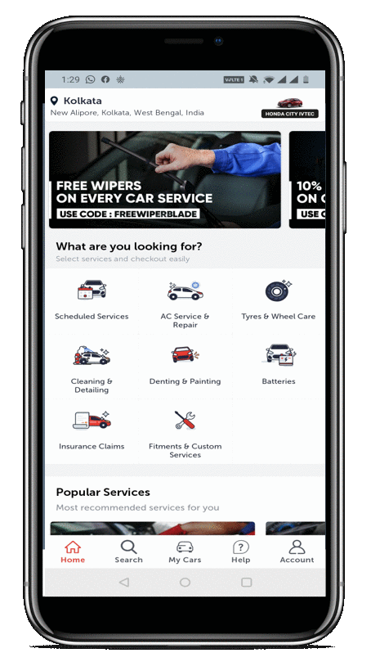


xx
Future plans
Market analysis
xx
App strategy
xx
xx
Branding strategy
Partnerships
The application being the primary touchpoint must follow best-in-class recommendations
Application Strategy
Application Priority Framework
5 clicks to book a service
Usability
Availability
Design
Professional
Visible Icon
Cross channel consistency on terms of color/theme and visual flow
Availability
Available on Google playstore and IOS
Redirect people from website and social media (pop-up)
Initial promotion on booking through application
Is your Application easily available?
Usability
Easy to use; Access to most services in 2-3 clicks. Final booking in no more than 5 clicks
Navigation
Sufficient clues available
Intuitive
Sliding banners for most used service and customer specific display
Search option to find useful services
Supportive Features
Option to directly chat with representatives
Chatbots and FAQs to address common queries
Supportive Features
Easy to reach helpdesk; chatbots; FAQs
Desirability
Desirability
One stop solution for all the needs of the target market; attractive user interface
Accessibility
Most useful features available after login
Final booking to not take more than 5 clicks
One stop shop for all kinds of servicing needs
Hassle free booking and tracking feature for consumer trust
5

Slide 7


xx
Future plans
Market analysis
xx
App strategy
xx
xx
Branding strategy
Partnerships
Overall branding strategy focusses on boosting demand while catalysing the supply
Branding Strategy
Overarching brandings strategy focusses on building synergies between two sides of the platform – that of demand and supply
Catalyze Supply
Boost Demand
Partner Growth Services
Channels
Channels
Advertisements
Perception
Management
Sentiment
Management
Sales
Promotion
CEO
Activism
6

Slide 8




xx
Future plans
Market analysis
xx
App strategy
xx
xx
Branding strategy
Partnerships
Demand side can be boosted by introducing more channels and improving overall promotions
Sales and advertising model
CHANNELS
ADVERTISING
PROMOTION
CEO ACTIVISM
1. PHYSICAL-
  Partnering with garages
  Fleet management for MNCs, delivery platforms
2. ONLINE
  Application
  Web browser
3. TELEPHONIC
  Helpline/Assistance
1. ONLINE
  Social media – Facebook, Instagram, Twitter
  Content broadcasters – YouTube, OTT platforms
2. OFFLINE
  Pamphlets @ partner garages
  Billboards @ highway motels
1. DISCOUNTS & OFFERS
  Discounts on next visit in 2-3 months time
  QR codes on posters for downloading app for first user discount
  Package deals/ bulk discounts
2. REFERAL PROGRAMS
3. GUERRILLA MARKETING
1. STANCE BUILDING
  Opinions on recent issues reflecting company’s stand
  Blogs, podcasts etc.
2. ASSOCIATION WITH CAUSE
  Overall support of the company to social causes
  CSR, mention of explicit volunteering work by employees on website
Regulatory Compliance
Effectiveness and Efficiency
Environmental Protection
Complying with across-government and
GPO requirements
regarding asset
management
7

Slide 9



xx
Future plans
Market analysis
xx
App strategy
xx
xx
Branding strategy
Partnerships
Supply side can be catalyzed by increasing partnerships while maintaining relationships
Supply side management
PARTNER MANAGEMENT
PERCEPTION MANAGEMENT
SENTIMENT MANAGEMENT
CHANNELS
1. PHYSICAL-
  On-ground team to facilitate partnership with garages
2. ONLINE
  Application
  Web browser
3. TELEPHONIC
  Helpline/Assistance
1. BUSINESS
  Best quality spare parts/ other resources to all partners
  Assistance in marketing activities and platforms
2. EVENTS
  City meets for partner garages for knowledge sharing and networking
1. UPSKILLING WORKFORCE
  Standard uniforms for all customer touchpoints
  Regular training and information of quality standards
  Special training on professionalism and customer handling
2. INCENTIVISING WORD OF MOUTH
1. COVID RELIEF
  Emergency monetary support to partners
  Minimum basic salaries in non-operational services
  Assurance of continuity of service post pandemic
2. BRANDING
  Facilitate internal branding of partners by annual all partners meetings
Regulatory Compliance
Effectiveness and Efficiency
Environmental Protection
Complying with across-government and
GPO requirements
regarding asset
management
8
Notes:
https://www.pitcrew.co.in/
https://gomechanic.in/delhi

Slide 10
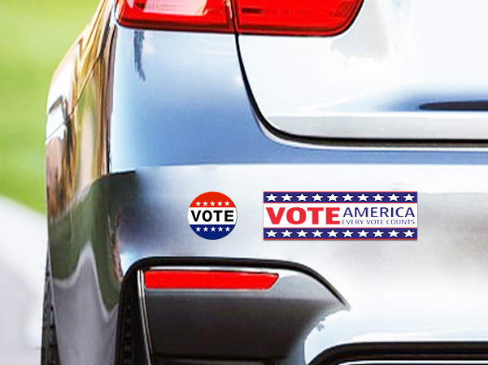
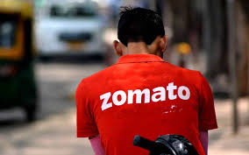
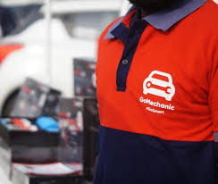
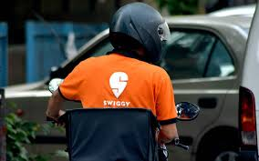

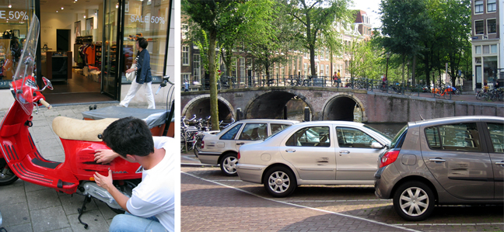
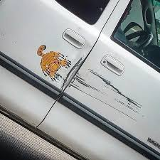

xx
Future plans
Market analysis
xx
App strategy
xx
xx
Branding strategy
Partnerships
Guerrilla marketing can be used to further increase the reach and recallability
Guerrilla Marketing Strategies
BUMPER STICKERS
UNIFORMS
CAR NOTES
SCRATCH STICKERS
We can fix that bumper. Won’t cost as much as you think !
We ensure your family’s safety in testing times!
NEED AND DISCOVERY
Life is too short to spend on a car repair!!
I can bang that dent out of you!
Nice car! A racing strip would be sick! Interested?
Witty stickers on bumpers, rims, windshields etc. attract attention in parking slots and traffic jams
Uniforms and toolkits with Careasy color scheme and logo ensures standardization and recallability
Personalized car notes (as per car condition) under windshields with Careasy business cards
Videos capturing reactions of people to new scratches on their cars, followed by Careasy vouchers
DESCRIPTION
Mobile marketing- 2.5x more effective than static
Brand identity and visibility – directly to target audience
Versatile, cheap and creative
CUSTOMERS
Colors increase brand recognition by 80%²
Free advertising and promotion
EMPLOYEES
Sense of belonging & responsibility
Personalization increases ROI by 20%³
Improvement in CRM
78% repeat customers in case of personalization of services³
Marketing initiative to be streamed on social media handles
Vouchers increase potential customer base by 18%
Increased reach as challenge
SERVICE
FULFILLMENT
IMPACT
COST
EFFORT
PERSONNEL
COST
EFFORT
PERSONNEL
COST
EFFORT
PERSONNEL
COST
EFFORT
PERSONNEL
FEASIBILITY
Sources: AdHitch, Desktop research, University of Loyla, Internal analysis

Slide 11





xx
Future plans
Market analysis
xx
App strategy
xx
xx
Branding strategy
Partnerships
Cost effective digital marketing is the way forward
Online Marketing Strategy
Cost-Effective Media Strategy
15%
Impressions (in lacs)
10/video
15-30/promotion
20-30/promotion
30%
CTR
0.33%
0.8%
0.6%
20%
Reach
3000-5000 / video
10k-30k/promotion
10k-30k/promotion
15%
CPC/CPM
Rs 15-25
-
-
20%
Estimated Cost
Others
Rs 40k-50k/video
~ 1.5 lac/promotion
~2 lac/promotion
While Instagram offers the best return on investment, facebook has the best potential in terms of target market. While Youtube is not the exact go to channel for advertising but can be used to improve consumer perception by advertising in the right Youtube channels
Strategy
Similar to Instagram’s strategy of hyperlocal targeting. Interests can be expanded based on groups and common search keywords used by consumers
Advertising on channels like Autocar India with customer segments limited by cities
Advertising with geo-fencing and specific age groups. Keywords to target can be automobile company and other car related interests
10

Slide 12













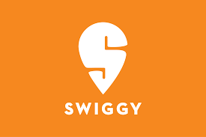


















xx
Future plans
Market analysis
xx
App strategy
xx
xx
Branding strategy
Partnerships
CarEasy has immense partnership opportunities in automotive and related industries
B2B Partnership Opportunities
Automotive Industry
Other Industries
Business Expansion
Luxury Hotel Chains
(e.g., Taj Hotels and Mariott)
Delivery Services
(e.g., Bluedart and Safexpress)
Ride-hailing Platforms
(e.g., Olacabs, Uber and Meru)
Car Rental Platforms
(e.g., Zoomcar and Droom)
Local Car Dealership Networks
Food Delivery Platforms
(e.g., Zomato and Swiggy)
Other Fleet Managers
(e.g., Corporate offices, Tour operators)
Service Excellence
Paints and Coatings
(e.g., Berger, Nerolac and Nippon)
Oils and Lubricants
(e.g., Shell, Castrol and Mobil)
Insurance Providers
(e.g., HDFC Ergo and TATA AIG)
Payment Platforms
(e.g., Google Pay, PayTM and Amazon)
Spare Parts and Emergency Repair
Coupon Websites
(e.g., Nearbuy, Littleapp and CouponDunia)
Sources: CRISIL Research, GoMechanic, Pitstop, Tracxn, Wrench, Internal analysis
11

Slide 13
xx
Future plans
xx
Market analysis
xx
xx
App strategy
xx
xx
xx
xx
Branding strategy
Partnerships
A few partnerships are easy wins that come with low effort and high gains in future
B2B Execution Map
High
Least Priority
Second Priority
First Priority
High
Ride-hailing Platforms
Luxury hotels
Delivery Services
Food Delivery Platforms
Car Rental Services
Impact of the Partnership
Coupon Websites
Payment platforms
Low
Insurance Providers
Oil and Lubricants
Paints and Coatings
Feasibility and Ease of Implementation
Sources: CRISIL Research, GoMechanic, Pitstop, Tracxn, Wrench, Internal analysis
12
Low

Slide 14









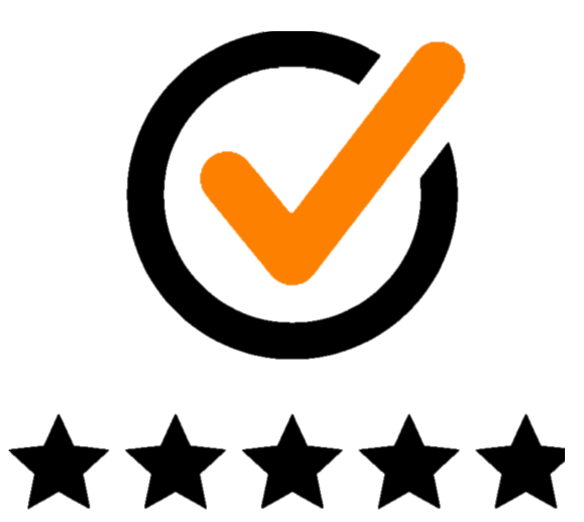


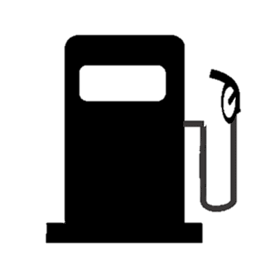
xx
Future plans
Market analysis
xx
App strategy
xx
xx
Branding strategy
Partnerships
Scaling up opportunities are huge in India, with alternate offerings necessary due to booming competition
Ramp-up plan and Alternate sources of revenue
Locations
Services
Service Offerings
Mumbai | Pune | Hyderabad | Bangalore
Periodic car service
Car cleaning & detailing
Wheel & rim care
Denting & painting services
Service warranty
Best services @ best prices
Convenient car care
Comprehensive 90 points checks
Genuine spares
Free pickup & drop
Delhi-NCR
Kolkata
Indore
Ahmedabad
Emergency response for car services like car towing, jumpstart, battery replacement etc.
Roadside assistance
Brakes, suspension, clutch, engine repair and custom packages as per requirement
Morning-ready
Emergency support
Custom repairs
Hassle-free denting painting & car repairs through cashless & zero dep insurance claims
Cashless insurance claims
Standard/High performance AC repairs
Top-up, filter cleaning, part replacement etc.
Car AC services
Rating mechanism
Live service tracker
Electric vehicle charging infrastructure
Wide range of batteries as per vehicle types
Battery charging / replacement
On-call fuel delivery in emergency cases
Refuelling options while servicing
Fuel delivery
Sources: MICA Market Intelligence, Internal analysis
13
Notes:
https://www.pitcrew.co.in/
https://gomechanic.in/delhi

Slide 15



xx
Future plans
Market analysis
xx
App strategy
xx
xx
Branding strategy
Partnerships
While the recommended changes bring a host of benefits, a significant amount of cost needs to be incurred for implementing it
Cost Benefit Analysis
Sources of Funds
Costs Associated
Particulars | Yearly
Number of cars | 40,000
Average Service Charge | 4000
Commission | 20%
Revenue (Commission) | 32,000,000
Cars requiring parts replacement | 30%
Average sale of OEMs | 4,000
Revenue (Sales of parts) | 48,000,000
Total Revenue |  | 80,000,000
Employee Cost | 30,000,000
Website/App | 500,000
Social Media Marketing | 10,000,000
Traditional Marketing | 5,000,000
Miscellaneous | 5,000,000
Raw material Cost | 20,000,000
Total Cost |  | 70,500,000
Net Profit |  | 9,500,000
Alternative Sources
Of Revenue
Expansion to services like bike servicing and others
Expertise to set up a new vertical would require new partnerships with garages
Partnering with B2B partners for long term contractual agreement
Setting up a new division to manage the partners. Offering at lower prices based on bulk deals
Partnering with insurance companies for a new proposed offering
Effort to partner with insurance companies and delivering the message to the consumers
Incremental Revenue
Increased reach through new marketing channels and decreased cost due to optimized supply side
Considerable spend on digital marketing and other channels to promote the service. Promo discounts to attract first time users
Assumptions:
Average Service Size is Rs 4,000 ( Competitor benchmarking)
Commission sharing at 80-20 in favor of garages
Raw Material Cost to be approximately 40% of Sales of part revenue
Notes:
https://www.pitcrew.co.in/
https://gomechanic.in/delhi

Slide 16


A crisp 3 months plan will improve the current positioning to capture competitor’s market share
Three Month Execution Plan
Week 1
Week 2
Week 3
Week 4
Week 5
Week 6
Week 7
Week 8
Week 9
Week 10
Week 11
Week 12
Align on brand/ agenda
Launch customer hotline
Commence partner branding/ city meetups
Revamp app(s) interface
Start Night Time Services
Execute “Away” Services
Start with new offerings
Continuous Initiatives (i.e., not dependent on timelines)
Launch customer service hotline
Online marketing campaigns and guerrilla marketing
B2B partnerships
COVID Initiatives (i.e., continued till foreseeable future)
Emergency family support
Minimum basic monetary support
Ensure continuity of service in line with regulations
Legend
Periodic Process
Permanent addition to service catalogue
15

Slide 17
THANK YOU

